Slide 1

Local Workforce Development Board
Department of Labor Overview
Rick Beasley
Executive Director
CareerSource South Florida

Slide 2

SFWIB Orientation Overview
Workforce Development Board Governance
  Local Workforce Development Board
  Membership Requirements
  Workforce Development Board Functions
SFWIB Governance
  Interlocal Agreement
  Purpose & Core Values
  Committee Structure
  SFWIB Strategic Goals

Slide 3
SFWIB Orientation Overview
Federal and Local Performance Measures
2023-24 Funding
SFWIB Operations

Slide 4

Local Workforce Development Boards
20 CFR 679.300
The Local WDB:
  Represents a wide variety of individuals, businesses, and organizations in the local area
  Serves as a strategic convener to promote and broker effective relationships between the CEOs and economic, education, and workforce partners.
  Must develop a strategy for continuous improvement and strengthening of the workforce system through innovation in, and alignment and improvement of, employment, training, and education programs to promote economic growth. Local WDB members must establish a platform in which all members actively participate and collaborate closely with the required and other partners of the workforce development system, including public and private organizations.

Slide 5
Local WDB Membership Requirements
§ 679.310(g)(7) is changed to say the local elected officials select not elect local board members
§ 679.310(g)(7) now refers to membership on the Local WDB, rather than the State WDB when referring to the conditions of appointment to the local board.
DOL: WIOA reduced the required local WDB membership in an effort to streamline the Boards and provide Chief Elected Officials the flexibility to establish Local WDBs that best reflect the diversity of job seeker and employer communities.
  § 679.320 (e)(4) gives the CLEO flexibility to appoint "other appropriate individuals DOL did not add any other required members

Slide 6
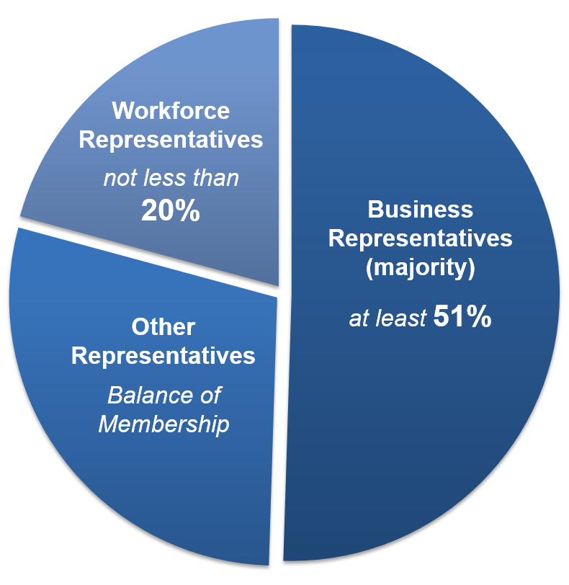
Local WDB Membership Requirements
Minimum Membership
Business Representatives
Workforce Representatives
Other Representatives to include:
  Adult Education/Literacy Providers
  Higher Education (including community colleges)
  Economic and Community Development
  Wagner-Peyser Employment Services
  Vocational Rehabilitation
  May include others determined appropriate by chief elected officials

Slide 7

Required Local WDB Members
§679.320
Local WDBs must follow State guidelines to document lack of a member type in the area.
Local WDB must follow state policy on membership criteria
  This includes criteria for selecting the representative of a title II eligible provider of adult education and literacy activities
  107(b)(2)(C)(i), § 679.320(d)(1) They must follow WIOA on soliciting nominations when there is multiple entities

Slide 8
Required Local WDB Members
§679.320
Twenty percent of the members must be Organized Labor
Adult Literacy Representation
Business Representation (§ 679.320(b) WIOA §107(b)(2)(A)(ii), describes Local WDB membership criteria)
  Small businesses representatives means more than one
  If the following meet the membership criteria in § 679.320(b)(1)&(2)[Note: if they are not considered to be business members they can fill the CLEO category]
    large non-profit organizations
    trade associations
    chambers of commerce
    aspirational industries.”
  The terms “high-quality, work-relevant training” as it applies to business representatives is left to be defined at the local level

Slide 9
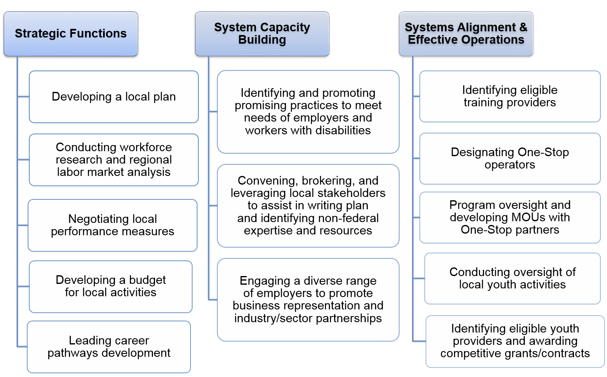
Local Workforce Development Board Functions

Slide 10
Local Workforce Development Board Functions
§ 679.370(h)(1) Requires local boards to develop strategies for technological improvements to improve one-stop services by facilitating connections among the intake and case management information systems of the one-stop partner programs
Comment: connecting intake and case management information systems will raise significant issues in terms of staffing, technology, and confidentiality.
DOL:
  20 CFR 679.370(h) does not outline specific technology requirements expectations
  The WDB is responsible for developing strategies for aligning technology and data systems across one-stop partner programs.
  The Local WDB may connect intake and case management systems, but neither WIOA nor the regulations require a single case management system among one-stop partners.

Slide 11
Local Workforce Development Board Functions
Local WDBs are to review applications from adult education and literacy Title II providers to determine whether the applications are consistent with the local plan and to make recommendations to the eligible entity
34 CFR part 463, requires the eligible (oversight) agency to establish i a processes as a part of the RFP by which applications must be submitted to Local WDBs for review prior to its submission to the eligible agency.
New - Only WDB members who do not have a conflict of interest can participate in the review of an eligible training provider applications
The eligible agency retains final approval authority.
Local WDBs must also replicate and implement cooperative agreements in accordance with 101(a)(11) (B) of the Rehabilitation Act of 1973 (29 U.S.C. 721(a)(11), and implementing cooperative agreements to enhance the provision of services to individuals with disabilities and other individuals.

Slide 12
Local Workforce Development Board Functions
Requires Local WDBs, & the CLEO to ensure appropriate use and management of funds.
Local areas should establish policies, interpretations, guidelines, and definitions to implement provisions of title I of WIOA to the extent that such policies, interpretations, guidelines, and definitions are not inconsistent with WIOA and the regulations, federal statutes and regulations governing one-stop partner programs, and State policies.
States should also establish policies, interpretations, guidelines, and definitions to implement provisions of title I of WIOA to the extent that such policies, interpretations, guidelines, and definitions are not inconsistent with WIOA and the regulations issued under WIOA, as well as Federal statutes and regulations governing one-stop partner programs. Local WDBs, therefore, can set policies but those policies must not conflict with State policy, or WIOA. No change to the regulatory text was made in response to these.

Slide 13

SFWIB Governance
About Us
The South Florida Workforce Investment Board is a public-private partnership that established federal and state funded workforce development and training program and policies for Miami-Dade and Monroe counties.
The South Florida Workforce Investment Board dba CareerSource South Florida (CSSF) is one of 24 Workforce Boards in the State of Florida. Its area of responsibility includes Miami Dade and Monroe Counties.
On March 7, 2006, the Miami-Dade County Board of County Commissioners (MDCBCC) adopted a resolution approving an Interlocal Agreement between the chief elected officials of Miami-Dade and Monroe counties. The approval of the agreement created the South Florida Workforce Investment Board (SFWIB) and its current administrative structure The Interlocal Agreement was extended in June of 2021.

Slide 14

SFWIB Governance
Interlocal Agreement
Members of the SFWIB serve at the pleasure of the Chief Elected Official who appointed the member for such term as determined by the Chief Elected Official who appointed the member. Miami-Dade County has 93.3 percent of the board appointments and any potential liabilities. Monroe County has 6.7 percent of the board appointments and any potential liabilities.
The SFWIB staff is a part of the Administrative Services of Miami-Dade County, which report to the CEO for Workforce Development Area (WDA) 23, which is the County Mayor of Miami-Dade County. The current County Mayor is the Honorable Mayor Daniella Levine-Cava.
The administrative entity for all Workforce Investment Act, TAI\F, and other workforce programs implemented by the SFWIB within WDA 23 of the State of Florida shall be the administrative service of Miami-Dade County. The administrative service, acting as the administrative entity for the SFWIB, shall serve the SFWIB under the supervision and control of the Executive Director of the SFWIB and shall implement the policies, decisions, actions and directives of the SFWIB under the supervision and control of the Executive Director of the SFWIB.
Notes:
Item 2. Key elements of the agreement include: (1) the roles and responsibilities of the SFWIB; (2) the election of a chairperson and members of the SFWIB as required by Federal and State law; (3) the roles and responsibilities of the SFWIB Executive Director.
Item 3. The SFWIB Executive Director will notify the CEO of any vacancies of the board. All nominees are required to complete an SFWIB Board Membership application for review, evaluation and submittal to the CEO for approval

Slide 15
SFWIB Governance
SFWIB Core Purpose & Core Values
Core Purpose
  CareerSource South Florida’s core purpose is to improve the quality of life through a workforce well equipped to meet industry demand.
Core Values / As a Board, We Value:
  Integrity and ethical behavior in all of our actions and dealings
  Fiscal and personal accountability
  Excellent service delivery
  Forward thinking, and innovation
  Passion and commitment to both internal and external customers
  Diversity in experiences and thinking
Notes:
Item 2. Key elements of the agreement include: (1) the roles and responsibilities of the SFWIB; (2) the election of a chairperson and members of the SFWIB as required by Federal and State law; (3) the roles and responsibilities of the SFWIB Executive Director.
Item 3. The SFWIB Executive Director will notify the CEO of any vacancies of the board. All nominees are required to complete an SFWIB Board Membership application for review, evaluation and submittal to the CEO for approval

Slide 16
SFWIB Governance
SFWIB Committee / Councils
The SFWIB has four (4) Committee / Councils in which policies and programs are reviewed and recommended to the full board for approval. The following are the committee/councils:
  Executive Committee - This Committee shall be responsible for making policy recommendations to the SFWIB on the matters assigned to it by the Chair or, in the event of a vacancy in the office of the Chair, by the Vice-Chair.
  Global Talent and Competitive Council - The Global Talent Competitiveness Council focuses on developing and delivering talent to meet marketplace needs to grow South Florida’s legacy and infrastructure industries as well as those industries that hold promise and have been identified as economic development priorities for diversifying the regional economy with high-wage jobs.
  Finance & Efficiency Council - The Finance and Efficiency Council’s primary goal is to work to ensure that the board is in good financial health, that its assets are protected, and the board’s resources are used appropriately and accounted for sufficiently.
  Performance Council - The Performance Council’s role is to ensure compliance with the federal common measures and to review and analyze Career Center, Youth and Refugee performance outcomes. These include both programmatic and financial outcomes on measures such as job placements, cost per placement and return-on-investment.
Notes:
Item 2. Key elements of the agreement include: (1) the roles and responsibilities of the SFWIB; (2) the election of a chairperson and members of the SFWIB as required by Federal and State law; (3) the roles and responsibilities of the SFWIB Executive Director.
Item 3. The SFWIB Executive Director will notify the CEO of any vacancies of the board. All nominees are required to complete an SFWIB Board Membership application for review, evaluation and submittal to the CEO for approval

Slide 17

SFWIB Governance
SFWIB Strategic Goals
The South Florida Workforce Investment Board
has Six Strategic Goals:
Build a Demand-Driven System with High Employer Engagement and Quality Business Services
Strengthen the One-Stop Delivery System and Increase Integrated Service Delivery
Improve Services for Individuals with Barriers to Employment
Dedicated Commitment to Youth Participation
High Return on Investment Through Continuous Improvement
Strong Workforce System Leadership

Slide 18
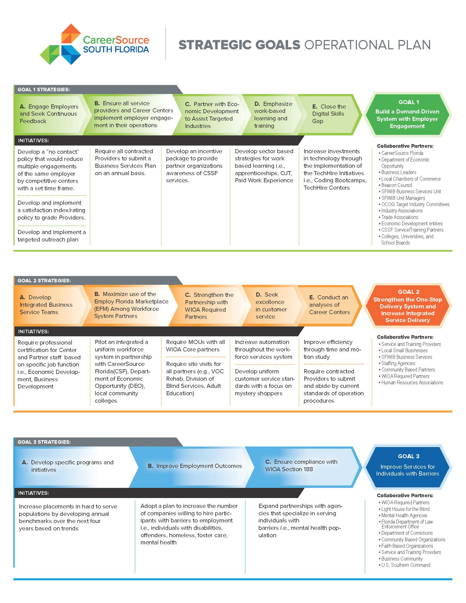
SFWIB Governance
SFWIB Strategic Goals

Slide 19
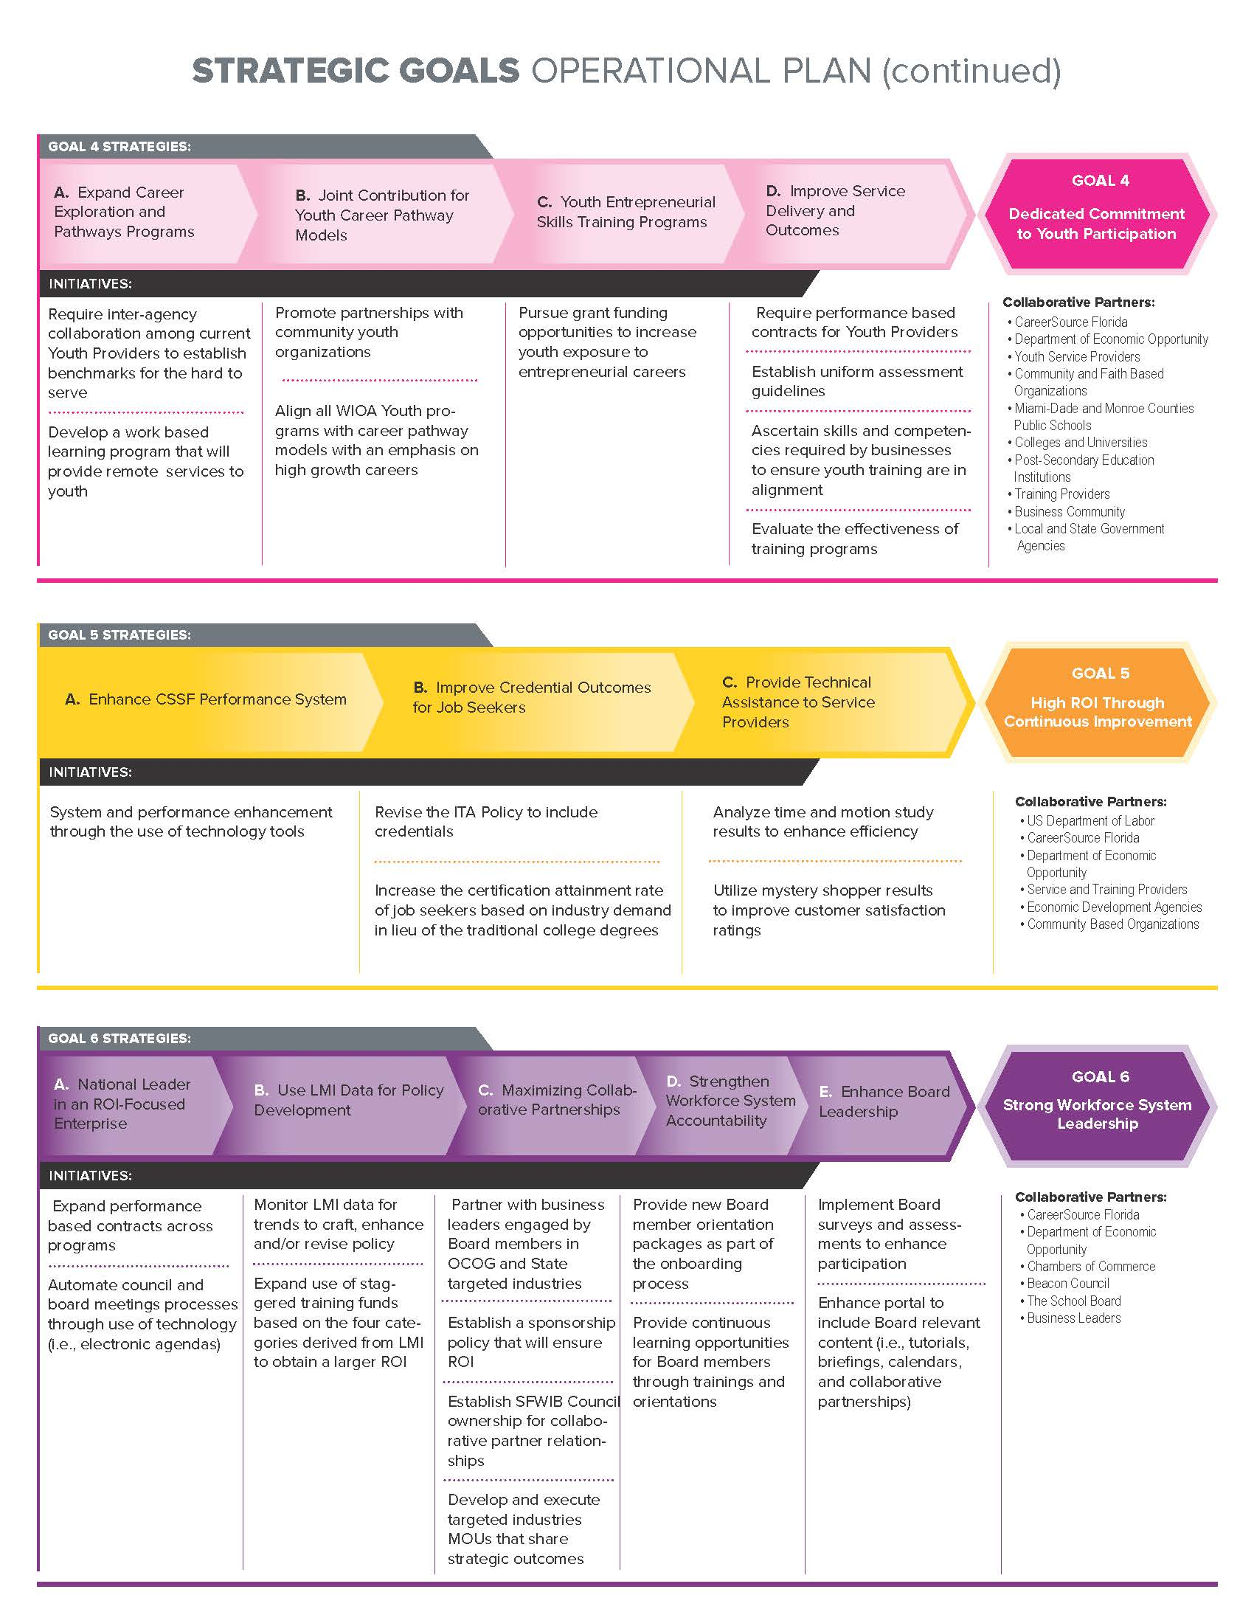
SFWIB Governance
SFWIB Strategic Goals

Slide 20

WIOA Federal Performance Indicators
WIOA Adult, Dislocated Workers & Youth:
  Employment 2nd Quarter after Exit
  Employment 4th Quarter after Exit
  Median Earnings
  Credential Attainment
  Measurable Skills Gain

Slide 21
WIOA Federal Performance Indicators
Wagner-Peyser Program:
  Employment 2nd Quarter after Exit
  Employment 4th Quarter after Exit
  Median Earnings

Slide 22
Performance Indicators
Performance Indicators | PY20-21 | PY21-22 | PY22-23 | PY23-24
$ Dollars Invested | $40,634,666.24 | $27,839,806.16 | $ 38,347,477.00 | $35,607,316.47
# of Placements | 11,446 | 4,182 | 4,375 | 6,668
Avg. Wage | $12.39 | $14.16 | $14.24 | $14.57
Cost Per Placement | $3,550.12 | $6,657.06 | $ 8,765.14 | $ 5,340.30
Economic Benefit | $22,221.08 | $22,795.74 | $ 20,854.06 | $ 24,965.30
ROI | $6.26 | $3.42 | $ 2.38 | $ 4.67
Economic Impact | $254,342,488.96 | $95,331,803.44 | $ 91,236,523.00 | $ 166,460,322.47

Slide 23
2023-24 New Program Funding
Funding Streams | PY22-23 | PY23-24 | Difference | % Difference
Adult | $ 7,202,678 | $5,710,976 | ($1,491,702) | -26.1%
Youth | $ 6,525,605 | $5,110,943 | ($1,414,662) | -27.7%
DW | $ 4,629,324 | $3,656,354 | ($972,970) | -26.6%
DW Supplement | $ 1,433,417 | $781,716 | ($651,701) | -83.4%
TANF | $ 6,998,494 | $11,519,447 | $4,520,953 | 39.2%
WP | $ 3,791,200 | $3,524,812 | ($266,388) | -7.6%
TOTAL | $ 30,580,718 | $30,304,248 | ($276,470) | -0.9%

Slide 24
SFWIB 2023-24 PROGRAM BUDGET
Workforce Programs | HQ | TRAINING | FACILITIES | CONTRACTS | TOTALS
Workforce Innovation Act
Adult | $1,898,242 | $ 4,049,583 | $ 890,908 | $ 3,285,225 | $10,123,958
Dislocated Workers | $1,796,267 | $ 3,832,037 | $ 843,048 | $ 3,108,740 | $ 9,580,092
Youth | $1,921,238 | $ 2,561,650 | $ 901,701 | $ 4,862,012 | $10,246,600
Temporary Assistance for Needy Families (TANF) | $2,403,087 | $ 2,400,000 | $ 1,127,849 | $ 6,885,529 | $ 12,816,465
Food Stamp Employment | $ 183,888 | $ 0.00 | $ 86,305 | $ 710,544 | $ 980,737
Re-Employment Assistance | $ 33,426 | $ 0.00 | $ 15,688 | $ 129,159 | $ 178,273
Wagner-Peyser | $ 424,577 | $ 0.00 | $ 1,839,835 | $ 0.00 | $ 2,264,412
Veterans | $ 4,135 | $ 0.00 | $ 17,920 | $ 0.00 | $ 22,055
Refugee Employment | $ 0.00 | $ 0.00 | $ 0.00 | $ 0.00 | $ 0.00
Trade Adjustment Assistance | $ 1,266 | $ 0.00 | $ 594 | $ 4,890 | $ 6,750
Other | $ 32,208 | $ 0.00 | $ 0.00 | $ 139,570 | $ 171,778
TOTAL | $ 8,698,336 | $12,843,271 | $ 5,723,848 | $19,125,670 | $19,125,670

Slide 25
Organization Governance
SFWIB Operations
Under the guidance of the Executive Director CSSF operates and/or overseas:
  1 Comprehensive Career Center
  11 Full Service Career Centers
  14 Access Points
  5 Mobile Assistance Units
  3 TechHire Centers
  2 University Career Development Centers (St. Thomas University & Florida Memorial University)
  1 Reemployment Center
Through a competitive process community based organizations and private entities are selected to operate the career centers and youth programs
  Career Center One-Stop Operators / Providers
    Youth Co-Op, Inc.
    Arbor E & T. LLC
  In-School Providers
    Youth Co-Op, Inc.
    Adult Mankind Organization, Inc.
    Cuban American National Council
  Out-of-School Providers
    Youth Co-Op, Inc.
    Adult Mankind Organization, Inc.
    Cuban American National Council
    Community Action Human Services Department
    Community Coalition

Slide 26
Major Initiatives and Priorities
The South Florida Workforce Investment Board dba CareerSource South Florida (CSSF) strategic vision is to continue to be a premier national provider of employment and career services. Our core purpose is to improve the quality of life through a workforce well equipped to meet industry demand. CSSF does this through six strategic goals.
1. Build a Demand-Driven System with High Employer Engagement and Quality Business Services
  Business Intermediaries
  Business Layoff Aversion Strategies
  Apprenticeship Models
    Miami-Dade County Public Schools Pre-Apprentice Construction Program
    Commercial Jet
    Bean Automotive
    Warren Henry
    Early Learning Coalition
  First Source Hiring Ordinances (various municipalities)
  Employed Worker Training Initiative (Website and Mobile App)
  Business Roundtables
2. Strengthen the One-Stop Delivery System and Increase Integrated Service Delivery
  University Career Services/Development Centers (Florida Memorial University and St. Thomas University)
  College Employment Initiatives
    MDC Works
    College of Florida Keys
  Miami Community Ventures / Beacon Council
  YWCA of Greater Miami-Dade TechHire Center
  Opa-Locka Community Development Corporation TechHire Center
  Integrated In-take Process / OIC of South Florida

Slide 27
Major Initiatives and Priorities
The South Florida Workforce Investment Board dba CareerSource South Florida (CSSF) strategic vision is to continue to be a premier national provider of employment and career services. Our core purpose is to improve the quality of life through a workforce well equipped to meet industry demand. CSSF does this through six strategic goals.
Improve Services for Individuals with Barriers to Employment
  Hospitality Institute Homeless Initiative (Camillus House / Chapman / Lotus)
  Women-In-Tech
  Camillus House Homeless Employment Center
  City of Miami Beach (Homeless Employment Initiative Program (HEIP))
  Community Habilitation Center, Inc. d/b/a The WOW Center
  Key Clubhouse of South Florida Employment Initiative
  Comcast Internet Essentials
Dedicated Commitment to Youth Participation
  Pre-Apprenticeship Career and Technical Training Programs
  Big Brothers / Big Sisters TechHire Center
  CareerSource South Florida (CSSF) TechHire Summer Boot Camp
  Summer Youth Employment Program (SYEP for City of Miami Gardens, City of Opa-Locka, and City of Homestead)
  Summer Youth Internship Program (SYIP with Miami-Dade Public Schools and the Children’s trust)
  Summer Youth Employment Program for Charter Schools (Miami-Dade County and the Children’s trust)
  Take Stock in Children Program – Scholarship Program
  Future Banker’s Training Program
  CSSF Education Portal

Slide 28
Major Initiatives and Priorities
The South Florida Workforce Investment Board dba CareerSource South Florida (CSSF) strategic vision is to continue to be a premier national provider of employment and career services. Our core purpose is to improve the quality of life through a workforce well equipped to meet industry demand. CSSF does this through six strategic goals.
High Return on Investment Through Continuous Improvement
  Automation Programs QA Monitoring Tool
  CFR Placement Tool
  Placement Validation Tool
  Balanced Scorecard Report
  Referral Verification Tool
  Referral to Placement Report
  Soft Exit Report
  Common Measures Tool
  Automated Performance Invoicing Process (APIP)
  Consumer Report Card
Strong Workforce System Leadership
  Monthly Partners Meeting
  Performance Improvement Team (PIT) Meetings
  Community Forums
  Business Services Roundtables
  Poverty Simulation

Slide 29
Implementation of WIOA
Through the implementation of the Workforce Innovation and Opportunity Act (WIOA), CSSF executes CareerSource Florida’s plan to have a business-led, market-responsive, results-oriented and integrated workforce development system. The enhanced system will foster customer service excellence, seek continuous improvement and demonstrate value by enhancing employment opportunities for all individuals, including those with disabilities. This focused and deliberate collaboration among education, workforce, and economic development networks will maximize the competitiveness of area businesses and the productivity of the local workforce, thus increasing economic prosperity. CSSF strategic vision for WIOA implementation will be realized by accomplishing these three goals:
Enhance alignment and market responsiveness of workforce, education, and economic development systems through improved service integration that provides businesses with skilled, productive, and competitive talent and Floridians with employment, education, training and support services that reduce welfare dependence and increase opportunities for self-sufficiency, high-skill and high-wage careers and lifelong learning.

Slide 30
Implementation of WIOA
Promote accountable, transparent, and data-driven workforce investment through performance measures, monitoring and evaluation that informs strategies, drives operational excellence, leads to the identification and replication of best practices, and empowers an effective and efficient workforce delivery system.
Improve career exploration, educational attainment, and skills training for in-demand industries and occupations for Florida youth that lead to enhanced employment, career development, credentialing and post-secondary education opportunities.

Slide 31
Areas of Concern and Technical Assistance
With a population of over five million, Miami’s metro area is the seventh most populous and fifth‐largest urban area in the United States according to the U.S. Census Bureau. WDA 23 ended 2015 with a 2.7 percent unemployment rate in Miami Dade County and a 1.8 percent rate in Monroe County. Job growth in the area has steadily increased over the past 5 years but fluctuations in per capita personal income over the same period of time have caused growing concerns, especially in the middle class. More specifically, the availability of affordable workforce housing in both Miami Dade and Monroe County as well as effective and efficient public transportation.
To address these concerns, CSSF works with the local Beacon Council under the One Community One Goal initiative. This initiative focuses on seven targeted industries: Aviation, Banking & Finance, Creative Design, Hospitality & Tourism, Information Technology, Life Sciences & Healthcare, and Trade & Logistics. Further analysis projects significant growth in six of those industries over the next seven years. Those industries are the following:
Trade, Transportation and Utilities
Education and Health Services
Professional, Scientific, and Technical Services
Other significant industries include Leisure and Hospitality and Financial Services

Slide 32
Overview of Service Provision
American Job Center Operations & Service Integration
Rick Beasley
Executive Director
CareerSource South Florida

Slide 33
Overview of AJC Operations
The SFWIB’s services and resources are available through a network of contracted service providers and partnerships, which provide a seamless and comprehensive array of education, job training, economic development efforts, and other workforce development services via:
  1 Comprehensive Career Centers
  11 Full Service Career Centers
  14 Access Points (County libraries and other partner agencies)
  5 Mobile Assistance Units
  3 TechHire Centers
  2 University Career Development Centers (St. Thomas University & Florida Memorial University)
  1 Reemployment Center

Slide 34
Governance Structure & Funding Streams
Each of the WIOA required partners are included in the CSSF one-stop delivery system. The partners and programs include, but are not limited to:
WIOA
Wagner-Peyser
Temporary Assistance to Needy Families (TANF)/Career Advancement Program (CAP)
Supplemental Nutrition Assistance Program Employment and Training participants
Reemployment Services and Eligibility Assessment Program
Trade Adjustment Assistance
Unemployment Compensation claimants
Migrant Seasonal Farm Workers
Jobs for Veterans Grant Programs (LVER and DVOP)
Career Technical Education programs authorized under Carl D. Perkins

Slide 35
Partnerships
The SFWIB’s delivery of services is enhanced by integration of available resources and collaboration through partnerships that establish guidelines to facilitate joint planning and evaluation of services, to develop more efficient management of limited financial and human resources and to reduce administrative costs.
All informal and formal partnerships ensure that the following principles of WIOA are implemented:
Increasing access and opportunities for employment, education, training and support services of individuals, particularly those with barriers to employment.
Improving the quality and labor market relevance of workforce innovation, education, and economic development.
Promoting improvement in the structure and delivery of services.
Partnering Agencies include but are not limited to:
Department of Vocational Rehabilitation
Miami Lighthouse for the Blind
Miami Dade County Transit System
OIC of South Florida
Department of Children and Family Services (DCF)
Social Security Administration
Early Learning Coalition
AARP- Senior Service Employment Program
Neighbors and Neighbors Association
Sant La Haitian Neighborhood Center

Slide 36
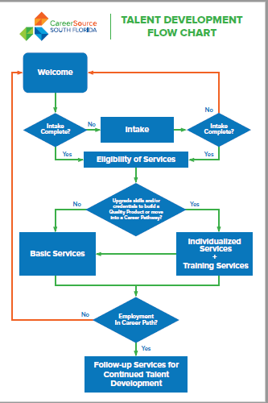
Customer Flow & Service Delivery
The SFWIB’s utilizes the Talent Development Flow Chart which, includes access to Intake, Eligibility of Services, Basic or Individualized Services, and Follow-up Activities, as mechanism to assess and assist jobseekers:
Intake is the collection of required documentation from jobseekers. The intake process includes, but is not limited to:
General Orientation: Provides the jobseeker with information pertaining to the services that are available.
Initial Application: Basic demographic and background information is collected; it also identifies employment barriers and specifies skill levels and gaps in specific areas. The initial application is accessible to the jobseeker through an online portal.
Complete EMD Registration: Requires jobseekers to complete a registration in the EMD database.
Literacy, numeracy, and skills testing will be determined using an assessment approved by the SFWIB.

Slide 37
Customer Flow & Service Delivery
Eligibility of Services
The Eligibility of Services is the determination of whether an individual is eligible to receive assistance under WIOA. Eligibility of Services is made upon reviewing documents collected during intake and shall be used to assist staff in determining if the participant is eligible for enrollment under WIOA. All available resources to reduce the amount of information requested from the participant to determine eligibility are used by staff (i.e. Suntax or Public Assistance Records). Referral to services shall ensure emphasis is placed on identifying barriers to employment, opportunities to improve skills and ways to acquire credentials and assist in the development of career pathways for talent pipelines, which results in better job candidates and employment outcomes.
Basic Services are informational in nature and available to all eligible jobseekers. These services include, but are not limited to:
Labor Exchange Services: This service provides jobseekers with job search and placement assistance, and in appropriate cases, career counseling, which includes information on in-demand industry sectors and occupations. Additionally, these services provide jobseekers with information on non-traditional employment and specialized recruitments targeting specific occupations or industries.
Current Labor Market Information (LMI): Jobseekers are provided the most current LMI available in an easy to understand and readily accessible format. The information includes job vacancy listings, job skill requirements necessary to obtain the job, information relating to local opportunities and earnings, and opportunities for advancement in such occupations.
Information and Referrals on Specific Programs and Services Available in the Community: Referrals are made to and activities are coordinated with other programs and services including other service or resource partners and vendors, to provide ancillary services within the one-stop delivery system.
Supportive Service Information: This service provides referrals to resources available through the SFWIB and/or the community to help reduce and/or eliminate barriers to employment. These services include: transportation, child care, dependent care, housing and needs-related payments that are necessary to enable an individual to participate in authorized activities.

Slide 38
Customer Flow & Service Delivery
Individualized services are provided to jobseekers that are eligible for WIOA and in need of services, in order to obtain and/or retain employment, which is determined pursuant to assessment information obtained during intake. These services include, but are not limited to:
Comprehensive Assessment: Each jobseeker who is eligible for services shall receive comprehensive and specialized assessments of their skill levels and service needs, which include diagnostic testing and in-depth interviewing and evaluation to identify employment barriers and appropriate employment goals. This process is intended to assist participants in identifying strengths, transferable skills, interests, work values, and priorities. This comprehensive objective assessment process underlies the development of an employment plan, which serves as each participant’s road map to services and should include the participant’s employment goals.
Individual Employment Plan: An individualized employment plan will be developed to identify the employment goals, achievement objectives, and appropriate combination of services or steps for the participant to achieve employment goals. The employment plan includes information on eligible training services providers and career pathways to attain career objectives.
Prevocational Services (Employability Skills): Short-term prevocational services include assisting the participant in any of the following: learning skills, communication skills, interviewing skills, punctuality, personal maintenance skills, and professional conduct, to prepare individuals for unsubsidized employment or training opportunities.
Workforce Preparation: This service includes activities, programs, or services designed to help an individual acquire a combination of basic academic, critical thinking, digital literacy, self-management skills, and competencies in utilizing resources, working with others, understanding systems, and obtaining skills necessary for successful transition into and completion of postsecondary education, training or employment.
Financial Literacy Services: This service provides participants with information pertaining to creating household budgets, initiating savings plans, and making informed financial decisions about education, retirement, home ownership, wealth building, and other savings goals. This service affords jobseekers with the opportunity to learn effective spending management methods, including addressing credit card debt. Financial Literacy Services include activities that address the financial literacy needs of non-English speakers, including the development and distribution of multilingual financial literacy and education materials.

Slide 39
Customer Flow & Service Delivery
Follow-up/Retention Services
Follow-up services are made available to all program participants for a minimum of 12 months after the first day of unsubsidized employment. Examples of WIOA Adult and Dislocated follow-up services
include:
Career planning and counseling
Assistance with work-related problems
Required contact with the participant’s employer
Peer support groups
Supportive service referrals
Information regarding educational opportunities
It is important to reiterate that follow-up services are provided to ensure the participant is able to retain employment, realize wage increases, and facilitate career progression.

Slide 40
Veteran’s Services & Priority of Service
WIOA enhances the focus on providing services to the most vulnerable individuals, who are low-income, have limited skills, lack of work experience and face other barriers to economic success. Services are provided to the following individuals: veterans, recipients of public assistance, other low-income individuals and individuals who are basic sills deficient for receipt of individualized career services and training services, as follows:
A. Recipient of Public Assistance
  Temporary Assistance for Needy Families (TANF)
  Member of a family that receives public assistance.
  Receives Supplemental Nutrition Assistance Program (SNAP) or that has been determined eligible for SNAP in the six months prior to the WIOA application date.
B. Basic Skills Deficient, including English language services (unemployed or
employed)
  An employed individual that scores at or below a ninth grade level.
  An employed or unemployed individual that is unable to compute or solve problems, or read, write, or speak English, at a level necessary to function on the job, in the individual’s family, or in society.

Slide 41
Veteran’s Services & Priority of Service
C. Low-Income (for employed or unemployed individuals)
  Recipients of re-employment Assistance
  The homeless
  A disabled individual whose own income meets the income requirements but who is a member of a family whose income does not meet said requirement
  Employed individuals that receives an income, or is a member of a family that receives a total income for the six months prior to the WIOA application date and in relation to family size, does not exceed the Family Income guidelines. The Lower Living Standard income Level for Miami-Dade is 200% and Monroe County is 250% over the 100% Metro for Area 23.
D. Services are provided to Employed Workers
  Employed individuals where the employer has contracted for training services to be provided through the Employed Worker Training Program.

Slide 42
LWDB Monitoring Activities
Service Providers
The purpose of the Quality Assurance (QA) strategy is to facilitate self-assessment reviews to ensure accuracy of data reported and collected. Participant files (hardcopy and/or electronic) and data systems are reviewed to ensure the following:
Ensuring data integrity and continuous improvement of system operations.
Reducing the error rate of Area 23 to three percent (3%) or less.
Ensuring compliance with federal, state and local laws, transmittals, directives, policies, procedures and regulations.
Service providers are required to conduct monthly QA reviews of ten percent (10%) or twenty-five (25) cases (whichever is less) of all SFWIB’s Programs with activities during the review period, which include, but is not limited to, WIOA, CAP, WP, RESEA, and SNAP E&T.
LWDB 23
The SFWIB conducts an annual monitoring of the service providers companies in a multi-layer strategy approach for contract, programmatic and fiscal compliance.
LWDB 23 Monitoring Tools
  Programs QA Monitoring Tool
  CFR Placement Tool
  Placement Validation Tool
  Balanced Scorecard Report
  Referral Verification Tool
  Referral to Placement Report
  Soft Exit Report
  Common Measures Tool

Slide 43
LWDB
Complaints & Grievance System
The Customer Service Unit is responsible for maintaining successful client relationships in order to identify customer objectives, constraints, goals and to develop a framework for responding to their needs. CSSF gauges the effectiveness of services to customers through a full time designated customer service representative, who handles all types to inquiries, complaints, and compliments.
The customer service representative attempts to resolve inquiries/complaints by speaking to customers, by telephone or e-mail, by contacting the one-stop career center staff to obtain additional information or documentation, to resolve the issue at hand if needed, by reviewing the databases, by obtaining information or authorization from the program manager or by referring the customer to an outside source for services not provided by CSSF. The customer service representative maintains a detail log documenting each inquiry or complaint received and the status of each one. A report is generated at the end of the month and submitted to CSSF Executive Director. The customer service representative also handles informal appeals

Slide 44
LWDB
Complaints & Grievance System
CSSF will measure general customer satisfaction by implementing and providing customers a survey at the time they complete the services on a random sample basis; the information gathered will help CSSF to best understand the needs and strategic goals of the clients and agencies

Slide 45





QUESTIONS & ANSWERS
Thank YOU
follow us on:

